Slide 1


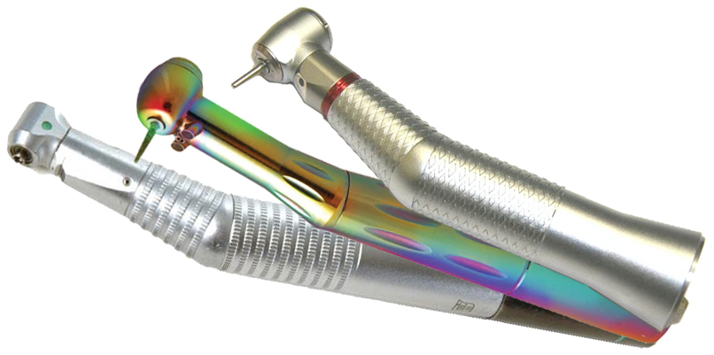
Optimizing your handpiece life!
By The Dentist’s Choice
Notes:
Hello, This tutorial will take you through the key roles proper maintenance and handpiece knowledge play in Maximizing your Handpiece Life and saving you valuable time and money.

Slide 2

The following lessons will help you maximize the life of your handpiece
Lesson 1 – Proper In-Office Settings
Lesson 2 – Sterilization Procedures
Lesson 3 – Lubrication
Notes:
To maximize handpiece life, we will take you through the importance of Proper In-Office Settings; Sterilization Procedures and proper handpiece lubrication.

Slide 3
Lesson 1
Proper In-Office Settings
  Handpiece Inventory
  Operatory Air Pressure
  Sterilization Equipment (Autoclave or StatIM)
  Lubrication Equipment
Notes:
Our first Lesson will focus on the importance of Proper In-Office Settings. These settings include, Handpiece Inventory, Operatory Air Pressure, your sterilization equipment and lubrication.

Slide 4
Handpiece Inventory
Please take a few minutes to count your handpieces in inventory
Having the correct number of handpieces in your office is very important
  All Manufacturers require 3 handpieces per operatory to optimize turbine life
    This typically allows for 1 handpiece ready for use by the doctor
    1 handpiece in the sterilizer
    1 handpiece cooling to room temperature
Notes:
Read slide info directly, try to time delay the info and ask the user to click their mouse to move to the next slide. Once jkdkkdl

Slide 5
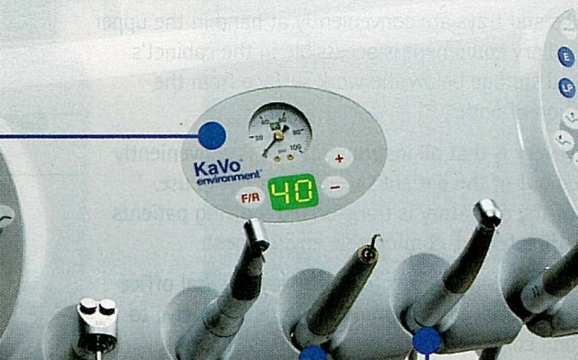
Operatory Air Pressure
Make sure your operatory’s air pressure is set correctly
As a rule of thumb, set it to 40 p.s.i.
For complete accuracy, refer to the p.s.i. chart included on this maintenance CD
*The KaVo station pictured at left shows the unit Air Pressure with both a Dial faceplate and also with a Digital reading
Notes:
All operatories are equipped with an air pressure gauge. This is the amount of air that is being provided to run the handpiece. Although all models of handpieces vary slightly in the exact amount of air pressure needed to run, A good rule of thumb is to set this Air Pressure to 40 p.s.i. You The Dentist’s Choice repair technician can further assist you with this adjustment if needed.

Slide 6
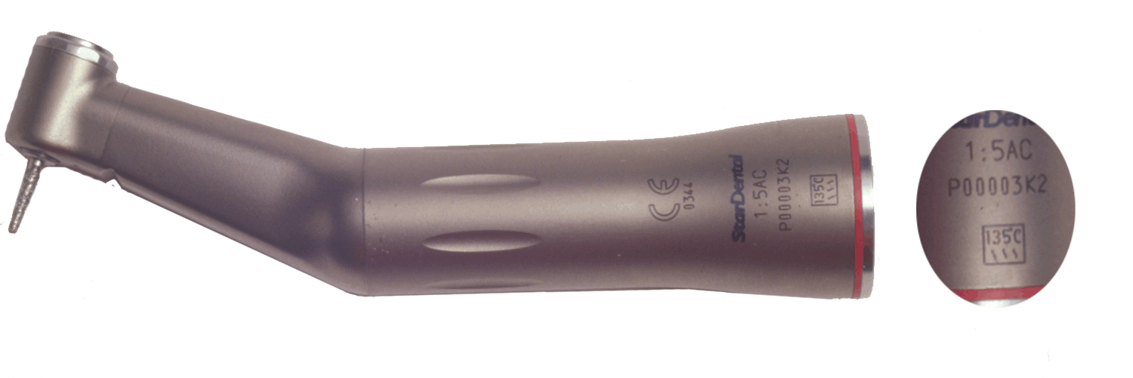
Sterilization - Autoclaves
Set to Correct Temperature
    Always between 121°C and 135°C
    Setting Autoclave temp above 135°C will cause internal handpiece damage
*As noted in the picture above, most handpieces carry a 135°C warning
Notes:
As you know, 121C will kill the various contaminants which may be present on a handpiece after use. So you must have your sterilization equipment adjusted Above this temperature. Unfortunately, your handpiece internal components will begin to breakdown under high temperatures of 135C. Please be sure your sterilization equipment is set below this temperature. A good safe setting for both infection control and handpiece safety is 132C. Again, your the Dentist’s Choice repair technician can assist you with proper sterilization equipment settings.

Slide 7
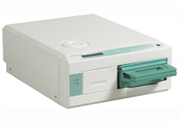
Sterilization - StatIM
The StatIM sterilization units have an automatic Handpiece-Cycle that we’ll visit in Lesson 2
Notes:
Simply read the text on the slide and ask the user to click to the next slide in the presentation.

Slide 8
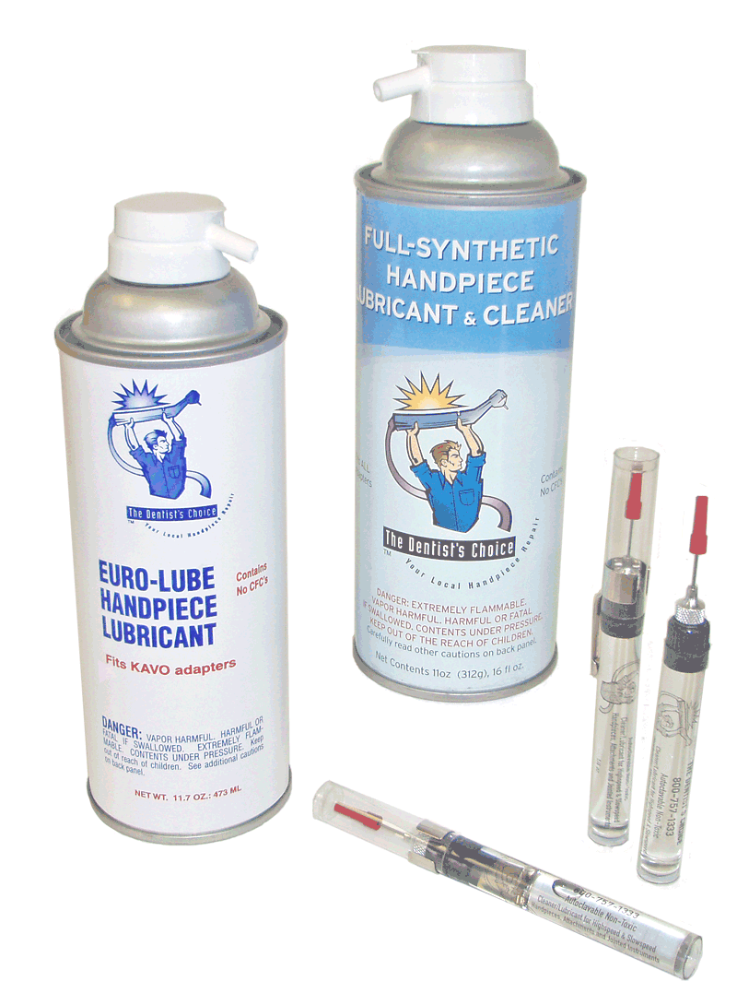
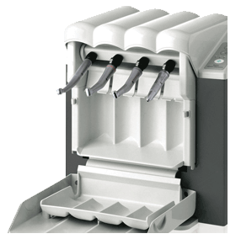
Lubrication Settings
Spray Lubrication
Pen Oilers
Dedicated Automatic Lubricators
Notes:
There are 3 styles of lubricating devices. The first, Spray lubrication, is the most popular in use today and has proven the test of time in both usefulness and cost savings. The Second type available are Pen Oilers. They are also very cost effective and easy to use. The final lubrication device available is an Automatic lubrication machine. They provide lubricant and then an air flush or purge phase but can be a bit costly.

Slide 9
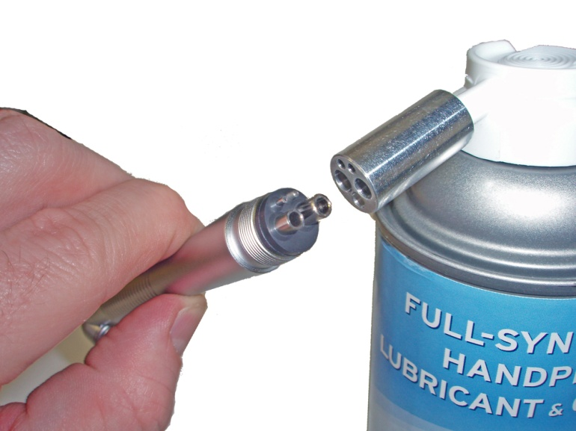
Spray Lubrication
Affix correct Nozzle
  When using Spray Lubricants, always have the correct nozzle for the handpiece being lubricated
* In the picture at left, we are correctly using a Fixed Back-End nozzle to lubricate a Fixed Back-End handpiece
Notes:
Simply read the text on the slide.

Slide 10
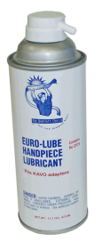
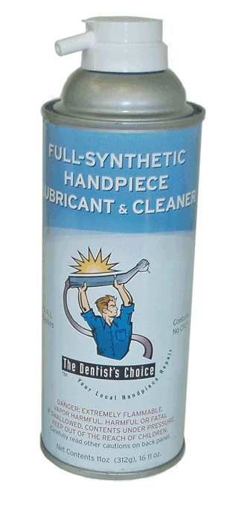
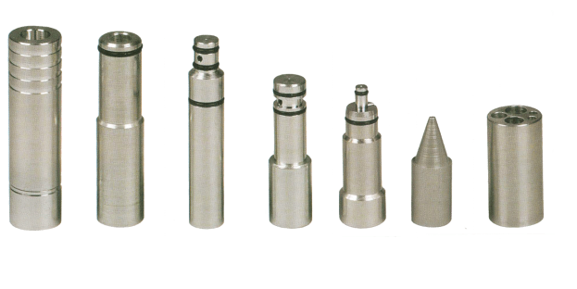
Spray Lubricants & Nozzles
Euro-Lube Handpiece Lubricant
  Ideal for your Highspeed Handpieces
Full-Synthetic Handpiece Lubricant & Cleaner
  Great for your Electric Attachments
    Also ideal for your Slowspeed Attachments
Nozzles
  We carry a full line of Nozzles for every handpiece model
Notes:
Our Euro-Lube handpiece lubricant is a natural oil lubricant which is thin in viscosity and is ideal for your highspeed handpieces. One quick burst of this lubricant before your sterilization process will clean out all of the internal bone and tissue debris and leave behind a coat of lubricant for the next handpiece use. Our next line of Spray style lubricant is our Full-Synthetic Lubricant & Cleaner. Its synthetic properties allow it to bond to the internal metal surfaces of your Electric Handpieces or Attachments while also flushing out all foreign materials. Finally, it is important and even vital that you have the correct spray can Nozzle for your type of handpiece. Again, you’re the Dentist’s Choice repair technician will provide this correct Nozzle for you.

Slide 11
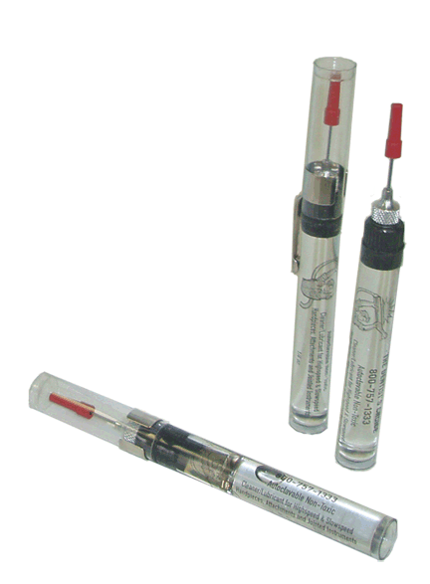
Pen Oilers
Typically, Pen Oilers are used exclusively on Slowspeed handpieces
  They are simple to use and you should always have a few in your office as a back-up to your highspeed lubrication systems
Notes:
Read the above text and then add: We will instruct you on how to correctly use pen oilers in Lesson 3 of this presentation.

Slide 12
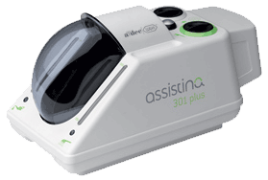
Automatic Lubrication
Stations
Check lubricant reservoir
  If it’s low, please fill it to the top line in the tank
Check that lubricant is flowing through the machine
  Do this by occasionally placing a piece of gauze in with the handpieces (If working properly, after the lubricant cycle, the gauze should be damp)
Notes:
Automatic Lubrication machines are easy to use and make the lubrication process quick and mess free. Before use, always check the reservoir to confirm it contains the proper amount of lubricant and cleaner. Sometimes, even though there is lubricant in the unit, it does not properly flow through the machine and into the handpiece. Occasionally check that: and read above text.

Slide 13
Lesson 2
Sterilization Procedures
  Autoclave
  StatIM
Notes:
There are 2 common types of handpiece Sterilizers. The Autoclave is the most popular and is easy to identify as it reminds most of us of an oven or kiln design. The other style is called a StatIM. It is gaining popularity with its cartridge type design and we will explain it proper use in an upcoming slide.

Slide 14
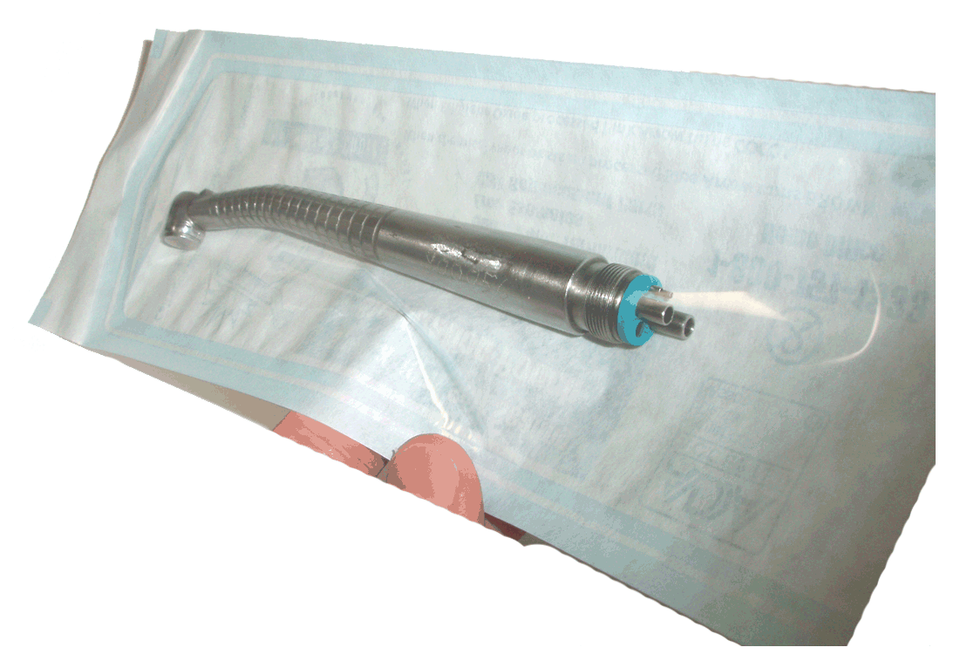
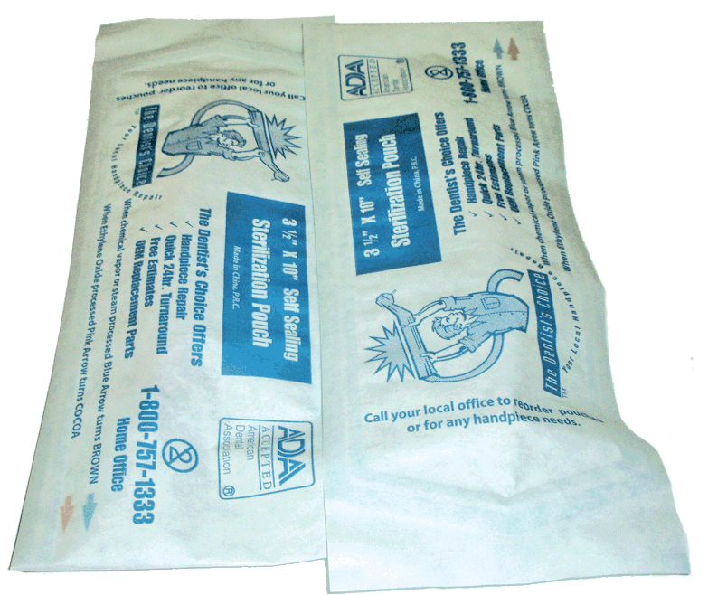
Sterilization - Autoclaves
Always use Autoclave Bags
  Using bags will protect the handpiece from external steam and prevent internal rust build-up
Place bags paper-side up
  This will allow water vapor to escape the bag and will also prevent overheating
*Step 1: Place handpiece in Autoclave bag, then seal the open end
*Step 2: Place bags paper-side up onto the Autoclave tray
Notes:
Simply read the above text and then add: The above procedure keeps handpieces from rusting internally and will lengthen their overall useful life by 2 to 4 years.

Slide 15
Sterilization - Autoclaves
Cooling
  Once the Autoclave cycle is complete, simply crack the door to the unit open approximately one inch
Then allow the contents to cool down slowly over one-half hour
You may then remove the handpieces safely
Notes:
Simply read the above text.

Slide 16

Important Cooling Warning
Always allow handpieces to cool down naturally
Never submerge handpiece in liquid
Do not place handpieces under running water
Notes:
Read the above text and then add: Quick cooling a handpiece will temperature shock the internal handpiece components. This causes them to crack and will ruin them immediately. An example I always share is that if you take a very hot glass dish or pan out of the oven and then put it in cold water in your sink, what will happen? Of course we all know that the dish will crack. It is this same “Quick Cooling’ effect that can damage your handpieces internal components. So please remember to Never Quick cool your handpieces.

Slide 17
Sterilization - StatIM
Always use Sterilization Bags
  Using bags will protect the handpiece from external steam and prevent internal rust build-up
Place bags paper-side up
  This will allow water vapor to escape the bag and will also prevent overheating
*Step 1: Place handpiece in Sterilization bag, then seal the open end
*Step 2: Place bags paper-side up onto StatIM cassette
Notes:
Simply read the above text and then add: The above procedure keeps handpieces from rusting internally and will lengthen their overall useful life by 2 to 4 years.

Slide 18
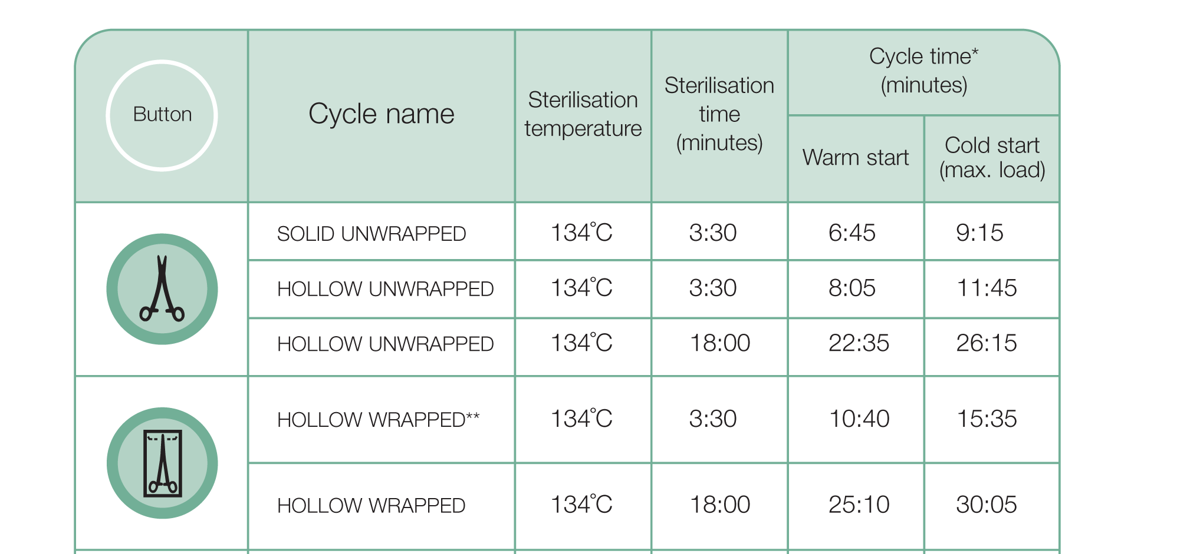
Sterilization - StatIM
Be sure to select the correct setting on your StatIM
  As noted below, it is the “Hollow Wrapped” cycle
Notes:
The StatIM has become popular recently because of its ability to more quickly sterilize your instruments. This is true with your dental pics, mirrors, scissors and scalers, but not with your dental handpieces. The folks at StatIM know that handpieces cannot be quickly heated and cooled like your other instruments and have allowed the user to change the StatIM sterilization setting to accommodate your precious handpieces. This setting for handpieces is called the “Hollow Wrapped” long cycle. Meaning that the instrument is hollow, like your handpieces and that it is wrapped in a sterilization pouch. The cycle time should be indicated as 25:10 or 30:05 as shown in the picture. Choosing a faster Cycle Time setting will potentially “Quick Cool” your handpieces and cause premature failure.

Slide 19
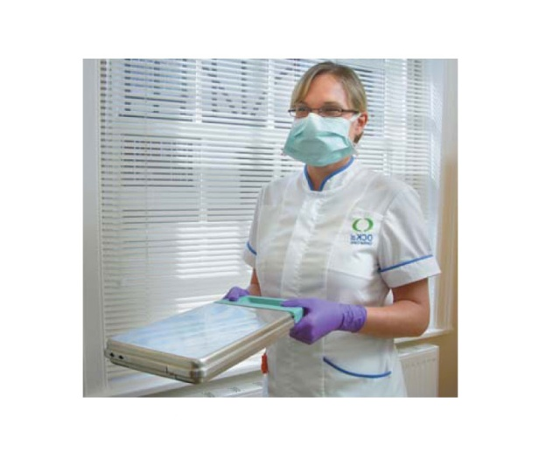
Sterilization - StatIM
Following the Sterilization Cycle
  Remove Sterilization Cassette from the StatIM and place it on your work surface
  Allow the contents to cool naturally to room temperature (approximately 30 minutes)
Notes:
Simply read text from above slide

Slide 20
Important Cooling Warning
Always allow handpieces to cool down naturally
Never submerge handpiece in liquid
Do not place handpieces under running water
Notes:
Read the above text and then add: Quick cooling a handpiece will temperature shock the internal handpiece components. This causes them to crack and will ruin them immediately. An example I always share is that if you take a very hot glass dish or pan out of the oven and then put it in cold water in your sink, what will happen? Of course we all know that the dish will crack. It is this same “Quick Cooling’ effect that can damage your handpieces internal components. So please remember to Never Quick cool your handpieces.

Slide 21
Lesson 3
Lubrication
  Lube Free Handpieces
  Highspeed Handpieces
  Slowspeed Handpieces
  Electric Attachments
Notes:
This Lesson will guide you through Proper Lubrication Techniques for all of your handpieces and attachments. These include Lube-Free handpieces, Highspeed handpieces, Slowspeed handpieces and Electric Attachments

Slide 22
Lubrication
Please follow the procedures on the upcoming slides as closely as possible
Proper lubrication is the most important factor in lengthening handpiece life
Notes:
Simply read the slide text.

Slide 23
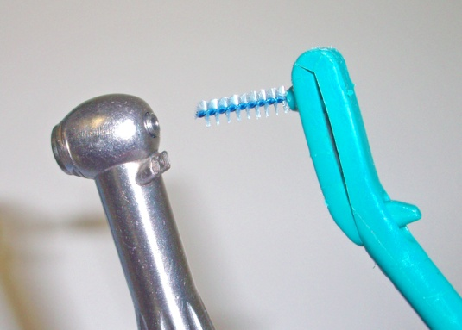
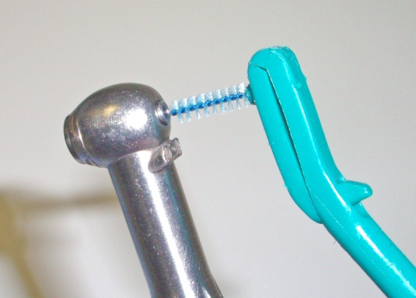
Lube Free Handpieces
No lubrication is required
To clean chuck
  Spray a small amount of cleaner onto a proxy brush; then insert the brush into the chuck to clean
To clean exterior
  Simply wipe the outer surface with cotton swabs containing a small amount of alcohol
Notes:
Simply read the text on the slide.

Slide 24
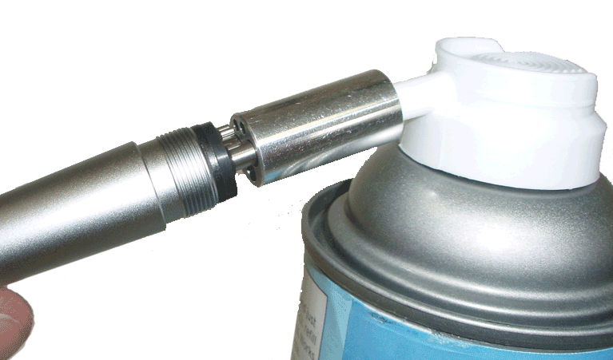
Highspeed Handpieces
Lubricate with your The Dentist’s Choice Euro-Lube prior to sterilizing
  Be sure to use the proper lubricant nozzle for your handpiece and also affix a Spray Guard to the handpiece head to avoid splatter
  Spray lubricant through the handpiece for a 1 second burst
  Purge with air for 15 to 30 seconds
  Sterilize
*Step 2: Push lubricant activator cap for 1 second
*Step 1: Push handpiece securely into lubricant nozzle
Notes:
First, read the text from the slide, then add: This procedure is instrumental in cleaning all of the tooth, blood and tissue debris from the inside of the handpiece prior to the sterilization process.

Slide 25
Highspeed Handpieces
Following sterilization, lubricate once more
You can lengthen the life of your handpieces up to 40% by lubricating them after sterilization as well
  Simply spray a 1 second burst of lubricant through the handpiece
  Purge on an air station or operatory for 15 to 30 seconds before use by doctor
Notes:
Read the text from the slide and then add: purging the handpiece with air following lubrication will remove all of the excess lubricant and cleaner from the handpiece. As a result, when used by the doctor, the bonding procedure will not be compromised.

Slide 26
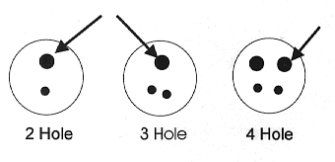
Slowspeed Handpieces
Using your Pen Oiler, place 3 drops of oil into the Drive-Air tube (see below)
Run the handpiece for 10 to 20 seconds
To clean exterior, simply wipe the surface with a cotton swab containing a small amount of alcohol
Sterilize the Handpiece
* The arrows point to the Drive-Air tube for the 3 different slowspeed back ends you may encounter
Notes:
Read the text and then add: Because of their slow running speeds, Slowspeed handpieces do not require the same dedication to lubrication as your highspeed handpieces. Pen oilers can provide sufficient lubricant, but they will not “Clean” debris from the handpiece. It is also recommended that you spray a 1 second burst of highspeed Euro-Lube into the handpiece once per week. This procedure is documented on the following slides.

Slide 27
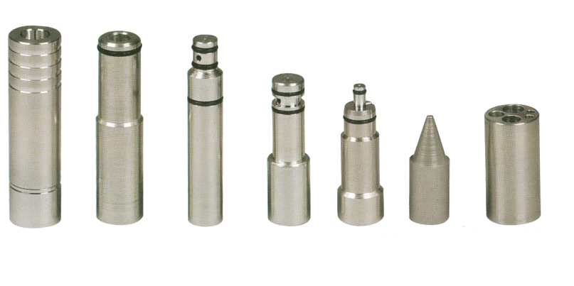
Slowspeed Handpieces
Lubrication for slowspeed handpieces that fit onto a swivel coupler
  Like most highspeed handpieces, you will need to affix the proper nozzle for your model of handpiece to a can of lubricant
  As mentioned earlier, we have a full line of lubricant nozzles for every handpiece make
Notes:
Simply read the text from the slide.

Slide 28
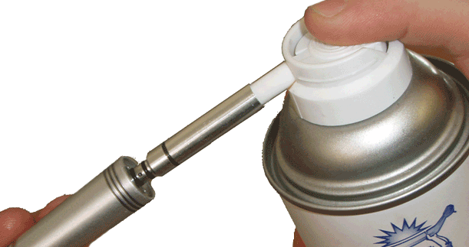
Slowspeed Handpieces
Lubricate your Slowspeed prior to sterilizing
  We recommend using our Full-Synthetic Lubricant & Cleaner
  Using the correct nozzle, spray lubricant through the handpiece for a 1 to 2 second burst
  Now run the handpiece for 10 to 20 seconds
  Sterilize the Handpiece
*Step 2: Push lubricant activator cap for 1 to 2 seconds
*Step 1: Push handpiece securely into lubricant nozzle
Notes:
Read the slide and then add: This procedure is important in cleaning any and all of the dirt and debris build up that accumulates in your handpiece over time. It is an important step in both infection control and also in adding months and even years to the life of your handpiece.

Slide 29
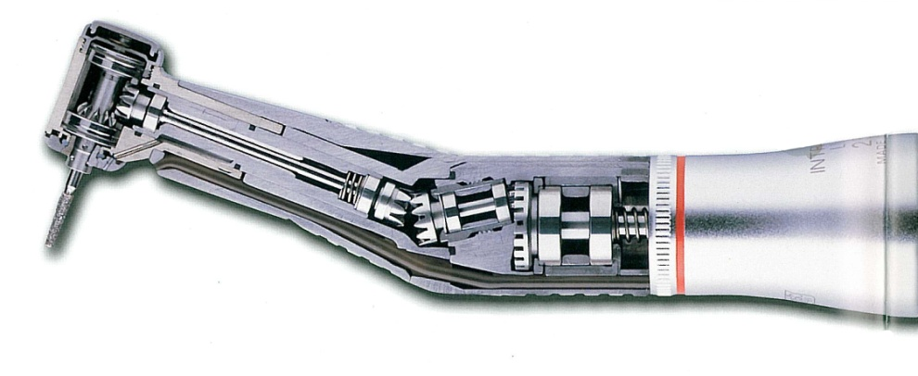
Electric Attachments
Lubricate ALL Electric Attachments with The Dentist’s Choice Full-Synthetic Handpiece Lubricant & Cleaner
  A synthetic lube is necessary for Electric Attachments due to their high speed and high number of internal moving parts
*Notice all the internal gears and bearings. Our Synthetic Lubricant will coat these internal components, greatly reducing wear and noise while lengthening handpiece life
Notes:
Read the text from the slide and then add: The largest enemy of electric handpiece life is Heat. By following these easy lubricating steps, Heat generation will be minimized both incrasing handpiece life and patient safety.

Slide 30
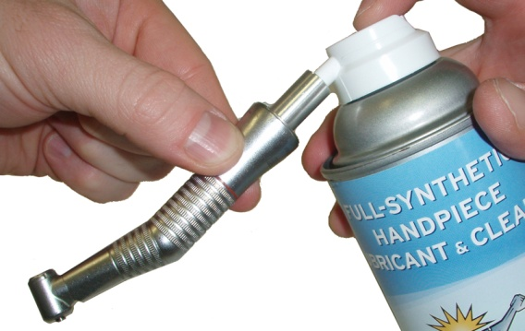
Electric Attachments
To lubricate, affix the Attachment nozzle to your can of Full-Synthetic Lubricant & Cleaner
Insert the nozzle firmly into the back of the Attachment and spray for a 2 second burst
While holding upside down, insert the Attachment onto a motor unit and run for 10 seconds
Sterilize the Attachment
Notes:
Running the attachment upside down will keep any excess lubricant from leaking into the motor unit. The electric motor itself cannot be lubricated as liquid will damage its internal components.

Slide 31
Maintenance Summary
Check Handpiece Inventory
  Remember – 3 Handpieces per operatory (minimum)
Sterilization
  Set Autoclave Temperature to max of 135°C
  Use sterilization pouches with paper side up
  Let handpieces cool naturally
Air Pressure
  Set operatory air pressure to 40 p.s.i.
  Refer to the handpiece p.s.i. chart for exact settings
Lubrication
  Lube Free – No lubrication required
  Highspeed – Use Euro-Lube for 1 second with proper nozzle
  Slowspeed – Place 3 drops of oil into Drive-Air tube with Pen Oiler
  Electric Attachments – Use Full-Synthetic Lubricant & Cleaner for 1 seconds with proper nozzle
Notes:
Read the text from the slide and then add: Please contact you’re the Dentist’s Choice repair technician for help with any of the items covered in this presentation or for any other handpiece needs.

Slide 32
Contact Info
Please call us with all of your handpiece related questions or for a quick pick-up
The Dentist’s Choice
Your Local Handpiece Repair
303-862-8869
Notes:
Thank you for taking the time to learn about proper handpiece maintenance and care techniques and thus greatly lengthening their useful life. Have a fantastic day and we look forward to becoming an important part of your support team.

